Slide 1

Where are we now and how can we learn more?
An introduction to improving our understanding of AS
Liz Loughery, Patient Registries Project Manager Alström Syndrome UK

Slide 2
What is a patient registry?
And why is it important for Alström syndrome?

Slide 3
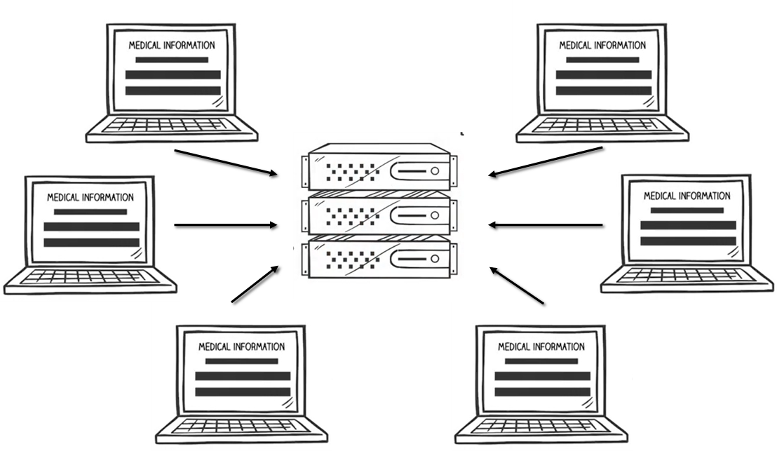
A patient registry is a database that collects information about people who are affected by a particular condition

Slide 4
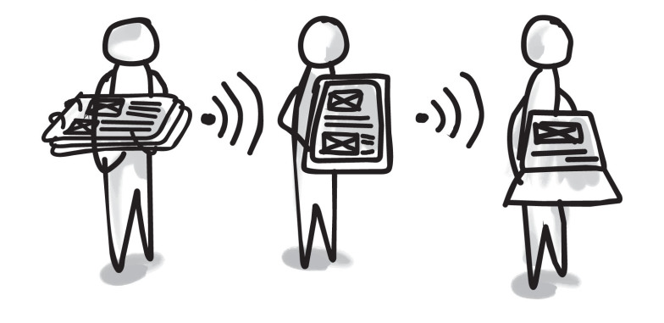
What type of information do they collect?

Slide 5
  Clinical history
  Medical Care
  Diagnostic tests
  Genetics

Slide 6
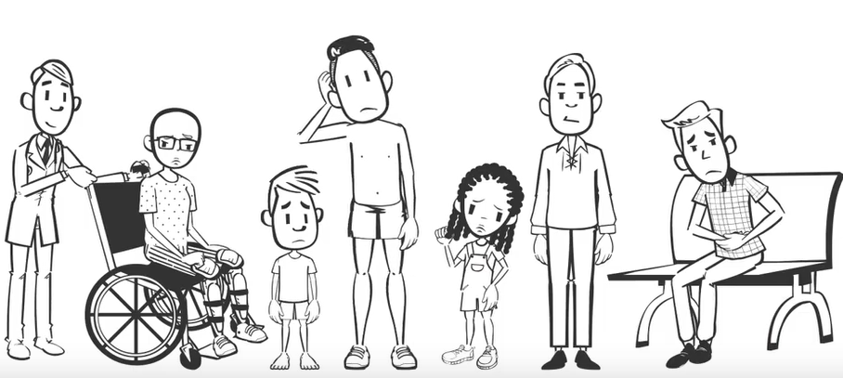
  Patient demographics
  (i.e date of birth, gender, birth year, gender, country, postal code, ethnicity)
  Lifestyle and health outcomes
  (i.e amount of exercise, diet & nutrition, alcohol etc)

Slide 7
Why are patient registries useful?
They help to build a more complete picture of a disease. This can support research studies, healthcare services, and patient group projects.
They can also improve understanding of how a disease progress through the average patients’ lifetime.
This information is useful for all health conditions but is particularly valuable in rare diseases where there tends to be a shortage of knowledge.

Slide 8
What can patient registries do?

Slide 9

1. Improve understanding
Patient registries help health professionals to understand a disease more fully which can enable new and improved treatments to be developed
They also help provide a better understanding of the how a disease progresses (also know as a disease natural history)

Slide 10
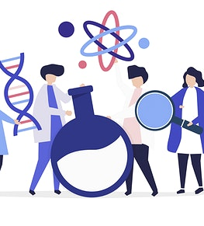
2. Support clinical research
Support patient recruitment for clinical trials
Enable support for clinical research – having a patient registry can raise the profile of a rare disease and awareness amongst researchers.
Researchers can analyse the data to inform research projects.

Slide 11
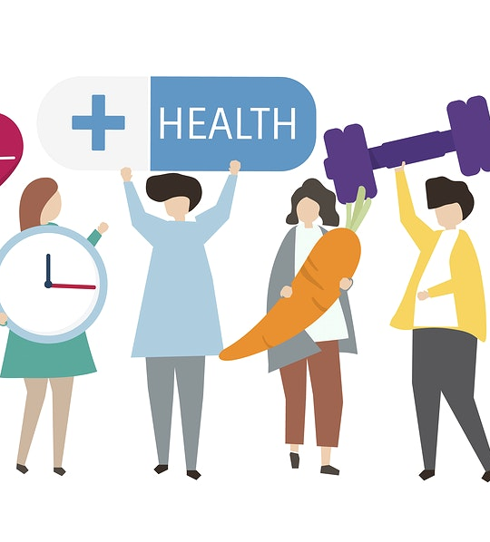
3. Support Health and Social Care
Patient registries can improve health and social care planning – understanding trends within a specific disease community can help evidence patient needs and decide how specialist clinics and services should be run.

Slide 12

4 .Enable you to HAVE YOUR SAY
For a registry to collect useful information it is vital that it is shaped by the patient voice.
A registry gives patients the opportunity to be counted and to contribute to research.
A registry can help patients understand more about their health and how they may differ from the average patient – this can help people plan their lives around their condition.

Slide 13

Why is this information important for us?

Slide 14
An Alström Syndrome UK Patient Registry
ASUK have recently embarked on a project to participate in a rare disease patient registry called CoRDS
CoRDS stands for the Coordination of Rare Diseases at Sanford University. It is an American based registry which holds patient information records for 7000 rare diseases
It is managed by the research arm of Sanford Health at Sanford University
CoRDS is available at no cost to patients, advocacy groups or researchers. It is completely free.

Slide 15

How does CoRDS work?
Advocates such as ASUK can create a disease specific questionnaire which patients and their families can complete
Researchers and Clinicians can apply for access to the data in CoRDS
Participants in the questionnaire are the primary owners of the data
The CoRDS registry is SECURE and participant information is protected

Slide 16
Is your information safe?
CoRDS never sells, rents or leases personal information
Information in CoRDS remains there unless consent to share is provided by the participant

Slide 17
How is CoRDS data used?
Researchers
  Sanford’s Scientific Review Committee may share anonymised patient data with researchers
Patient Advocacy Groups (i.e. ASUK)
  Can use data for non research purposes such as for education
  Only after Participant has given consent to share
Pharma
  Industry can notify CoRDS of disease specific trials. CoRDS will then direct participants to the appropriate contact if they are interested in learning more about a clinical study

Slide 18
Rare disease patients as CoRDS participants
Many of the world’s experts in rare disease are the patients and families themselves!
In order to study the natural progression of a disease it is important that participants update their information and quickly as their conditions change

Slide 19
CoRDS raises awareness and educates
New discoveries are made based on the information contained in the natural history of a disease
Patients own their stories. By sharing each story, scientists and doctors learn more about how to approach rare disease research and treatment.

Slide 20
Any questions?

